Slide 1


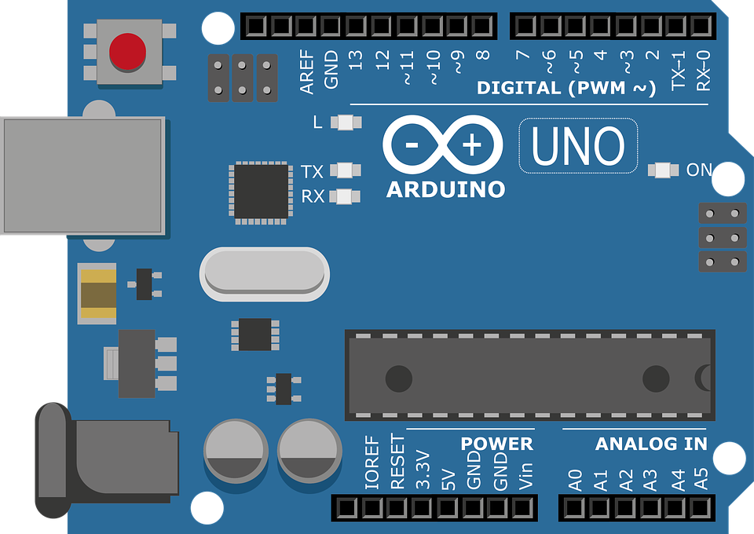
Arduino Workshop #1
https://github.com/jimenezjose

Slide 2
Getting Started
Download the Arduino IDE
Get a Breadboard
An Arduino Uno
Male to male wires
An LED
A servo

Slide 3
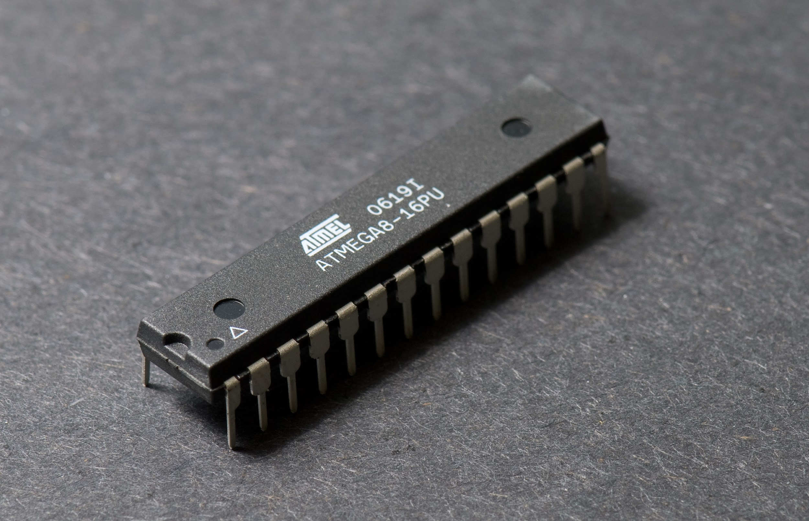
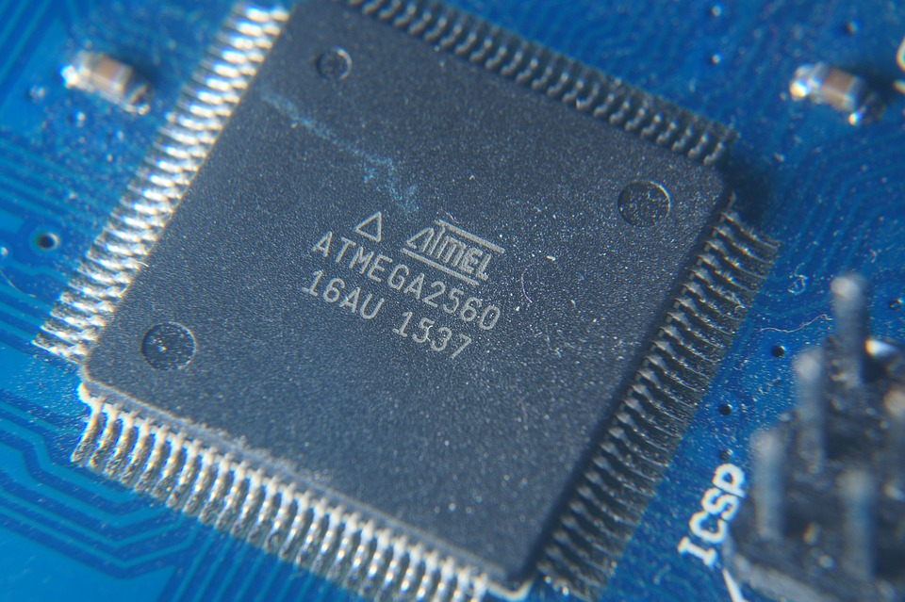
What is a Microcontroller
A low powered integrated circuit that has
a built in processor, memory, and I/O
pins.

Slide 4
Introduction to C
#include <stdio.h>
int main() {
printf( “Introduction to C\n” );
return 0;
}

Slide 5
Introduction to C++
#include <iostream>
int main() {
std::cout << “Introduction to C++” << std::endl;
return 0;
}

Slide 6
Why C/C++?
When working with embedded systems, C and C++ allow low level compatibility with the machine you’re programming.
Low-level languages produce more efficient code
The reason? The instructions in C and C++ are easily translatable to the instructions in assembly.
C and C++ are considered to be close to the hardware

Slide 7


Slide 8
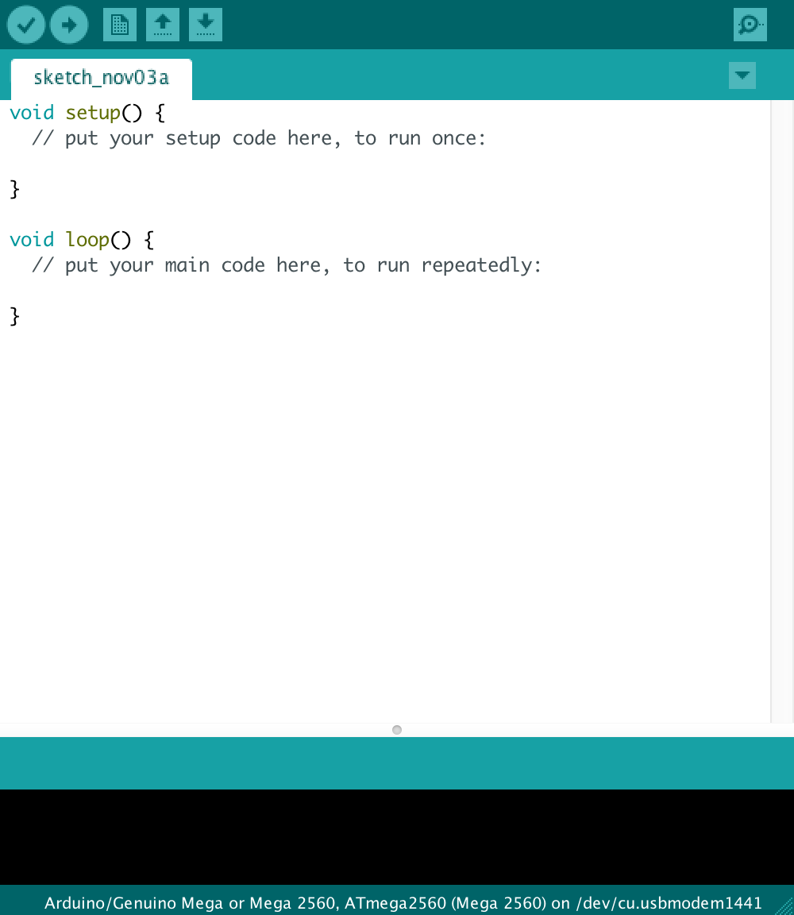

Slide 9
Make an LED blink
As simple as it sounds LEDs are your best friends.
So let’s get familiar with them.
Follow the README

Slide 10

A Circuit

Slide 11
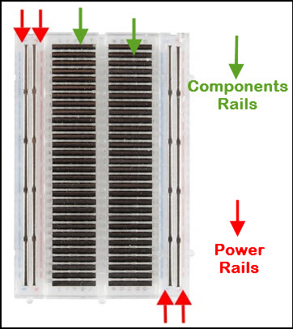
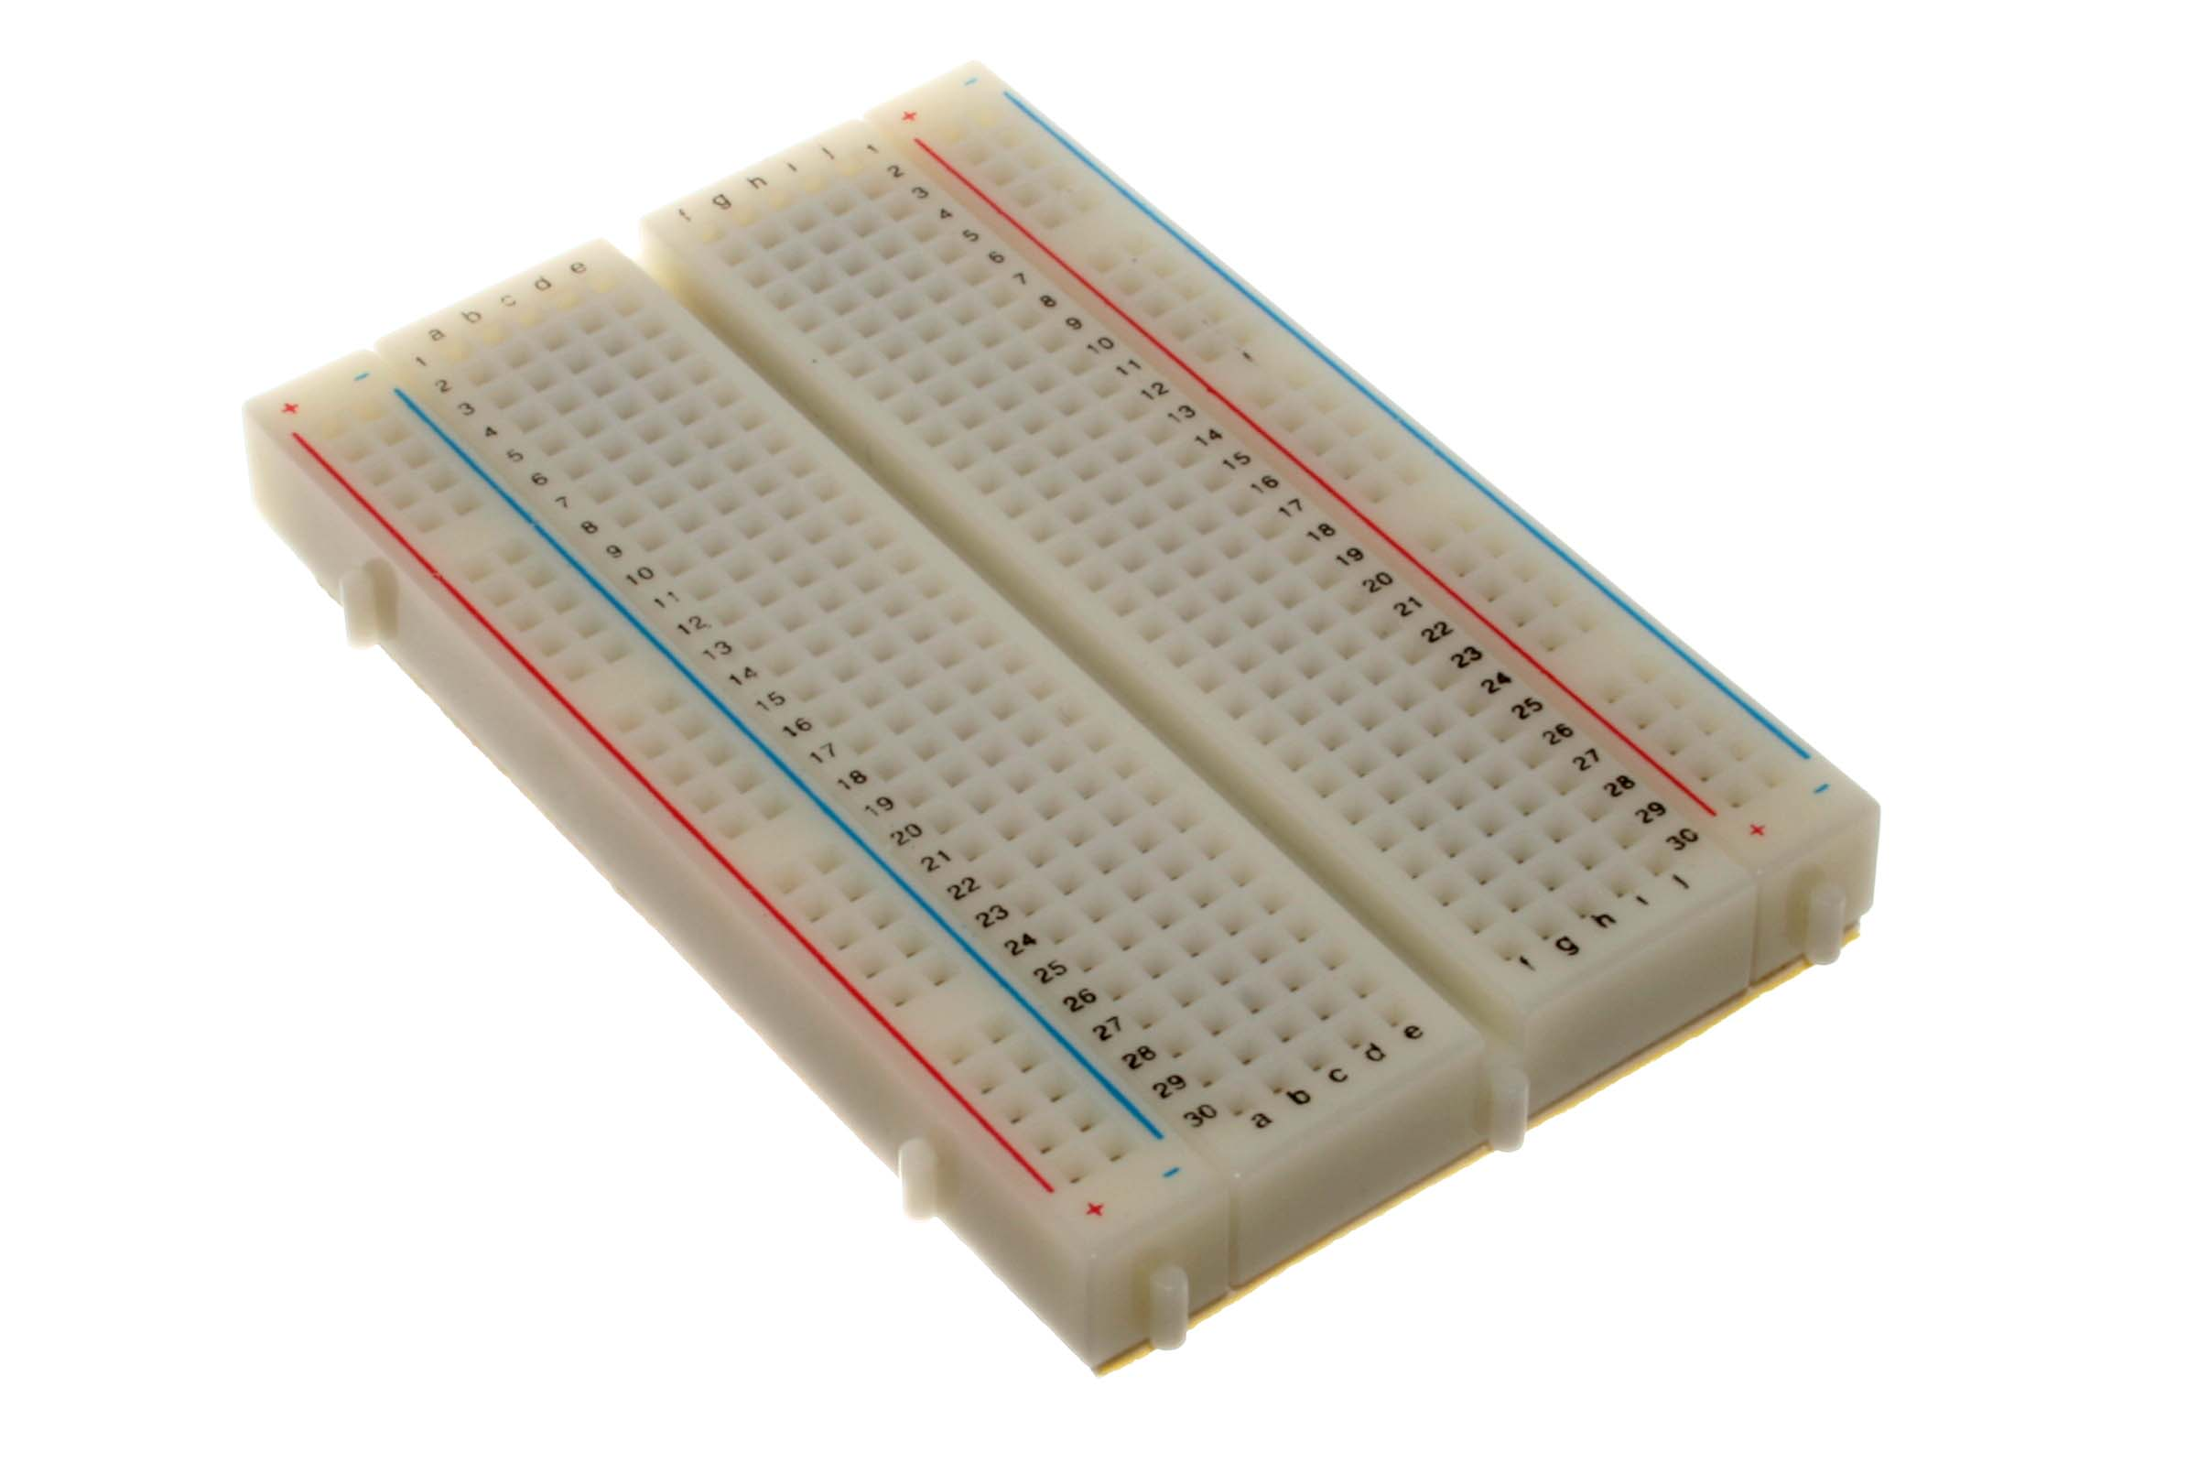
A Breadboard

